Slide 1
Biodiversity in the national parks service
Biodiversity CAPSTONE Project

Slide 2
Overview
Highlights of National Park Services’ species
Conservation efforts applied to animal and plant species
Consideration of which categories of wildlife are more likely to be endangered
Highlights of observations of diverse species within national parks
Impact of Foot and Mouth disease on sheep population

Slide 3
Species overview
5541 unique species over 7 category types
Mammal, Bird, Reptile, Amphibian, Fish, and Vascular or Nonvascular Plan
Conservation status falls into 4 categories when intervention has occurred :
Species of Concern: declining population or appears to be in need of conservation
Threatened: vulnerable to endangerment in the near future
Endangered: seriously at risk of extinction
In Recovery: formerly endangered, but currently not in danger of extinction throughout all or a significant portion of its inhabitable range

Slide 4
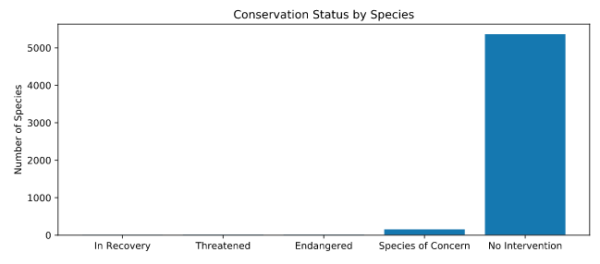
Species Conservation Status
Only a small portion of wildlife currently exist on the conservation status spectrum and are in need of intervention
Notes:
151 species categorized as Species of Concern
declining population or appears to be in need of conservation
10 species categorized as Threatened
vulnerable to endangerment in the near future
15 species categorized as Endangered:
seriously at risk of extinction
4 species categorized as In Recovery:
formerly endangered, but currently not in danger of extinction throughout all or a significant portion of its inhabitable range
5363 species have had no intervention

Slide 5
Which species are more likely to be endangered?

Slide 6
Focus of intervention efforts to date
Category of Species | On the Conversation Spectrum | No Intervention | Percent Protected
Amphibian | 7 | 72 | 8.9%
Bird | 75 | 413 | 15.4%
Fish | 11 | 115 | 8.7%
Mammal | 30 | 146 | 17.0%
Plant-Nonvascular | 5 | 328 | 1.5%
Plant-Vascular | 46 | 4216 | 1.1%
Reptile | 5 | 73 | 6.4%
A larger percentage of birds and mammals have needed intervention efforts to date

Slide 7
Mammals compared to other species
Species of mammals and birds have received more intervention efforts than amphibians, fish, plants and reptiles as a a proportion of their total
However, there is no statistically significant difference in the levels of intervention required between mammals and birds, mammals and fish, or mammals and amphibians
Results of a chi-square test indicates a pvalue=0.688, pvalue=0.056, and pvalue=0.128 respectively
There is a statistically significant difference in the levels of intervention required and therefore levels of endangerment when comparing mammals and reptiles or mammals and plants
Results of a chi-square test for mammals and repites indicates a pvalue=0.038; under which we reject the H₀ that mammals are not more endangered than reptiles

Slide 8
Highlights from week long observation efforts
There are three species of sheep that have been observed in national parks over the course of seven days:
Ovis aries=Domestic Sheep
Ovis canadensis=Bighorn Sheep
Ovis canadensis sierrae=Sierra Nevada Bighorn Sheep
Sightings of these species have been limited to the Bryce National Park, the Great Smoky Mountains National Park, Yellowstone National Park, and Yosemite National Park

Slide 9
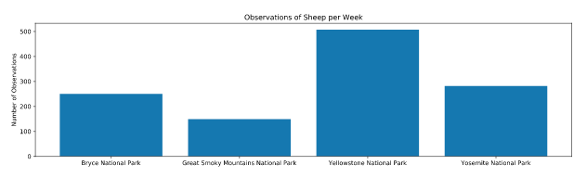
Sheep Observations by national Park

Slide 10
Combating Foot and mouth disease
Yellowstone National Park has introduced a program to reduce the occurrence of foot and mouth disease among its sheep population
Last year 15% of sheep at Yellowstone had the disease
Leveraging A/B Testing to determine effectiveness of program:
If observing sheep at Yellowstone and Bryce National Parks, conservationists would need to observe 510 sheep to determine (at a 90% confidence level) if foot and mouth disease incidents had been reduced by at least 5%
Such numbers would require a week long observation at Yellowstone and two weeks at Bryce

